Slide 1

VELLORE SMART CITY PROJECT

Slide 2
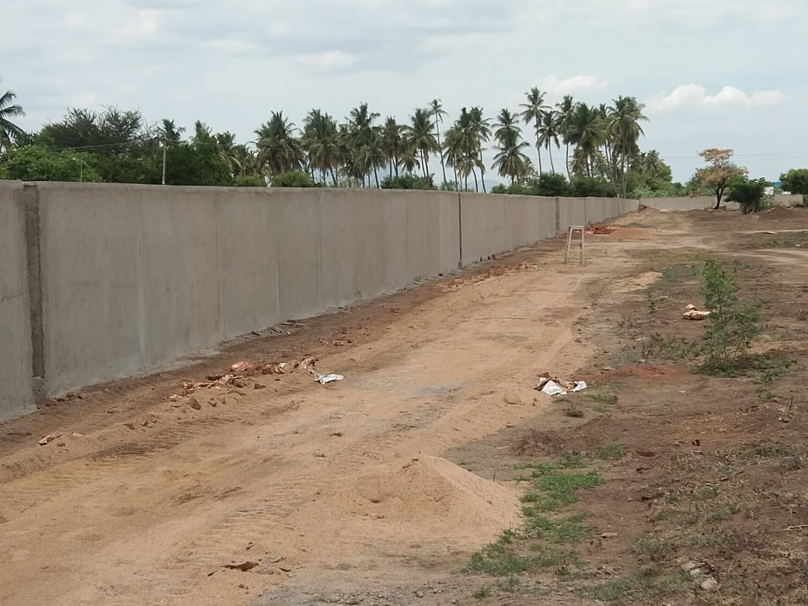
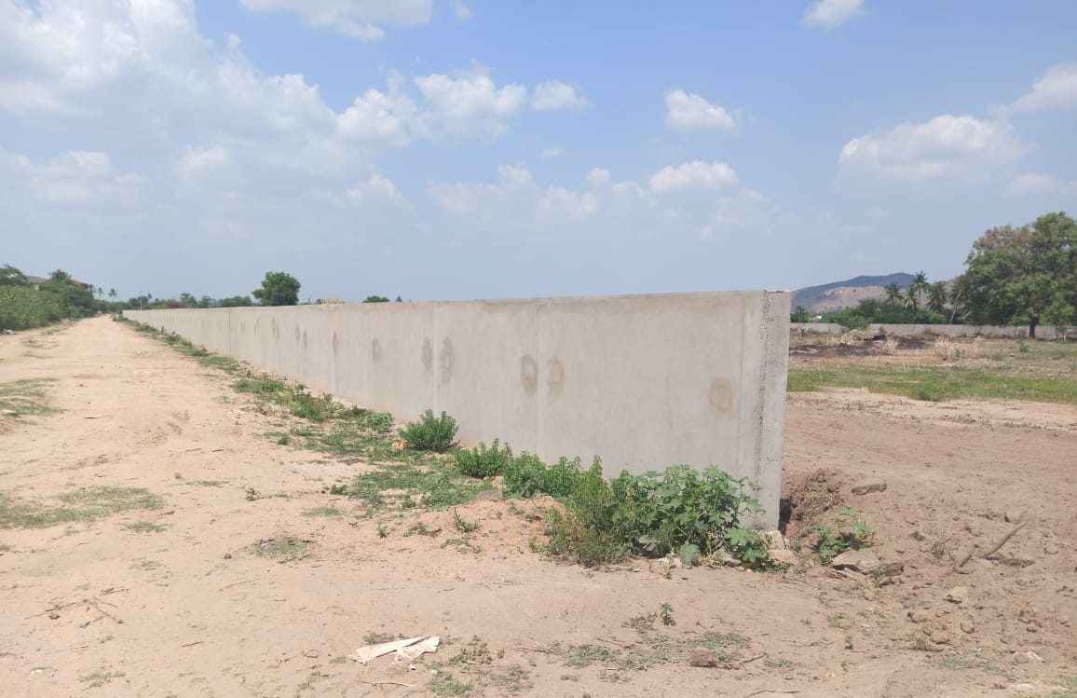
Ground Mounted Solar Power Plant (2.40MW)
1. | DESCRIPTION OF WORK | : | Design, Supply, Installation, Commissioning, Operation & Maintenance of solar power plant at North side & South Side of Vellore Corporation’s STP area Palar river (2x1.2 = 2.4MW)
2. | PROJECT COST | : | Rs. 13.24 Crores
3. | DATE OF TENDER | : | 04.09.2018
4. | NAME OF THE CONTRACTOR | : | M/s JS Associates development & Espen Enterprises (JV)Pvt Ltd, Coimbatore.
5. | AGREEMENT DATE | : | 09.03.2019
6. | AGREEMENT AMOUNT | : | Rs. 11.18 Crores
7. | AGREEMENT PERIOD | : | 10 months (09.01.2020)
8. | PRESENT STAGE OF WORK | : | 1. Compound Wall 1050m/1200m completed, balance 150m will be completed by 16.08.2020. 2. Third Party Inspection completed. Materials to be dispatched.
9. | DATE OF COMPLETION | : | 30.09.2020
10. | PERCENTAGE PROGRESS | : | Jun-20 | Jul-20
 |  |  | 31% | 40%
11. | EXPENDITURE | : | Rs. 0.75 Crores

Slide 3
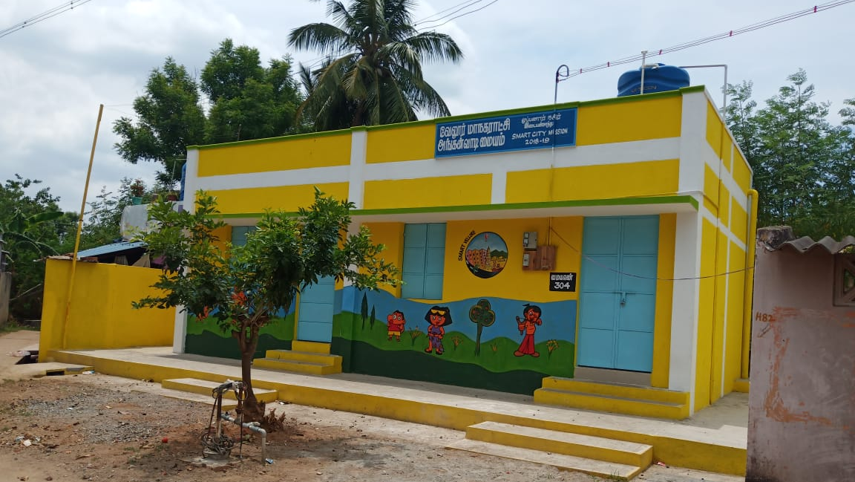
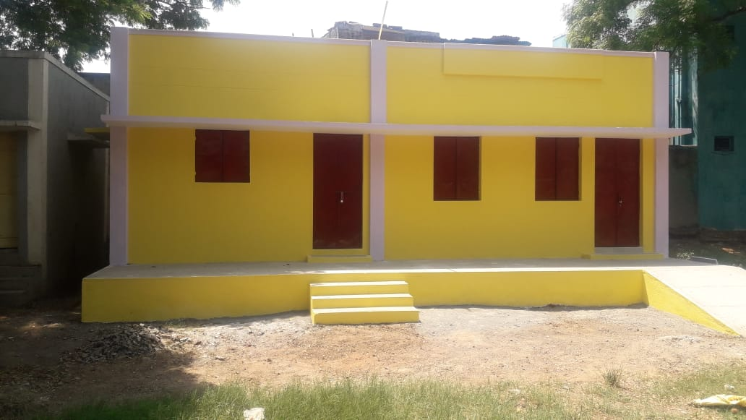
Anganwadi (Zone 1 -12, Zone 2-21, Zone 3-20, Zone 4 - 21) (Total - 74)
1. | DESCRIPTION OF WORK | : | Construction of New Anganwadi Centres in (Zone 1 -12, Zone 2-21, Zone 3-20, Zone 4 - 21) (Total - 74)
2. | PROJECT COST | : | Rs. 9.67 Crores
3. | DATE OF TENDER | : | 20.11.2018
4. | NAME OF THE CONTRACTOR | : | N.S.Construction, Gudiyattam - Pkg 1 - 12 nos Thiru S.Sivakumar, Gudiyattam - Pkg 2 - 21 Thiru R.S Prabhakaran,Vellore - Pkg 3 - 20 M/s Kay Yes Constructions, Vellore - Pkg 4 – 21
5. | AGREEMENT DATE | : | 04.01.2019
6. | AGREEMENT AMOUNT | : | Rs. 8.04 Crores
7. | AGREEMENT PERIOD | : | 6months(04.07.2020)
8. | PRESENT STAGE OF WORK | : | i) 47 Works completed ii) 25 Works in progress iii) 2 works to be started | Completed | Completed | Pending
 |  |  |  | Package 1 - 10 Package 2 - 10 Package 3 - 11 Package 4 - 16 | Package 1 - 10 Package 2 - 10 Package 3 - 11 Package 4 - 16 | Package 1 - 2 (Basement) Package 2 - 11 Package 3 - 9 Package 4 - 5 (2 Progress 3 to be started)
9. | DATE OF COMPLETION | : | 30.09.2020
10. | PERCENTAGE PROGRESS | : | Jun-20 | Jul-20 | Jul-20
 |  |  | 80% | 84% | 84%
11. | EXPENDITURE | : | Rs. 5.27 Crores

Slide 4
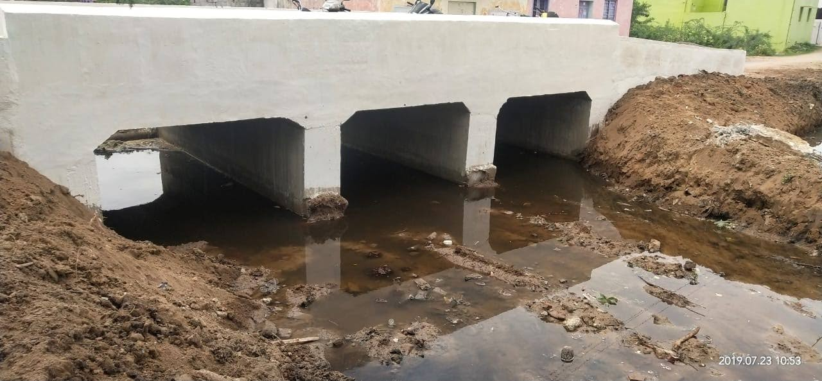
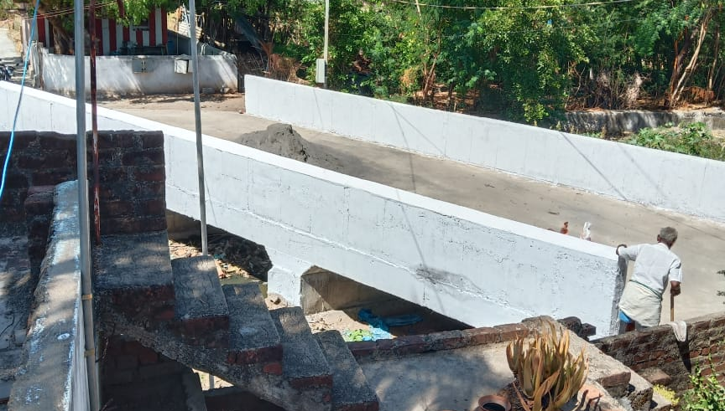
Construction of Culverts (Zone1- 82, Zone 2- 41, Zone 3- 41, Zone 4- 34 (Total - 198)
1. | DESCRIPTION OF WORK | : | Re-Construction of Existing Culverts (Zone1- 82, Zone 2- 41, Zone 3- 41, Zone 4- 34 (Total - 198)
2. | PROJECT COST | : | Rs. 5.00 Crores
3. | DATE OF TENDER | : | 20.11.2018
4. | NAME OF THE CONTRACTOR | : | D.Ezilkumar, Vellore - Pkg 1 - 82 Culverts P. Radhakrishnan, Vellore - Pkg 2 - 47 Culverts Thiru T. Arivazhagan, Vellore - Pkg 3 - 30 Culverts M/s Kay Yes Construction, Vellore - Pkg 4 - 29 Culverts
5. | AGREEMENT DATE | : | 04.01.2019
6. | AGREEMENT AMOUNT | : | Rs. 4.32 Crores
7. | AGREEMENT PERIOD | : | 5 months (04.06.2020)
8. | PRESENT STAGE OF WORK | : | i) 178 Culverts Completed ii) 12 Culverts in Completing Stage iii) 8 Culverts to be Commenced | Completed | Pending
 |  |  |  | Pkg 1 - 82 Culverts Pkg 2 - 47 Culverts Pkg 3 - 30 Culverts Pkg 4 - 29 Culverts | Pkg 1 - 0 Culverts Pkg 2 - 0 Culverts Pkg 3 - 0 Culverts Pkg 4 - 2 Culverts (Minor Bridge)
9. | DATE OF COMPLETION | : | 30.06.2020
10. | PERCENTAGE PROGRESS | : | Jun-20 | Jul-20
 |  |  | 94% | 98%
11. | EXPENDITURE | : | Rs. 4.32 Crores

Slide 5
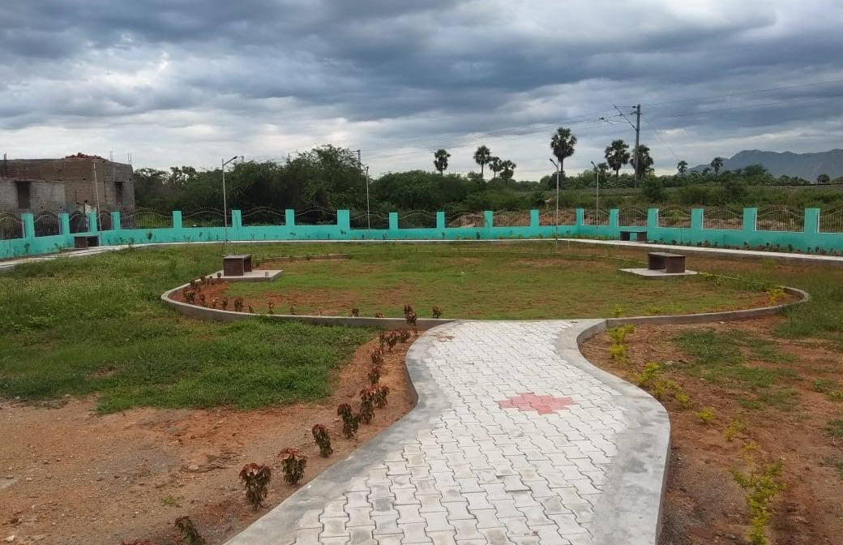
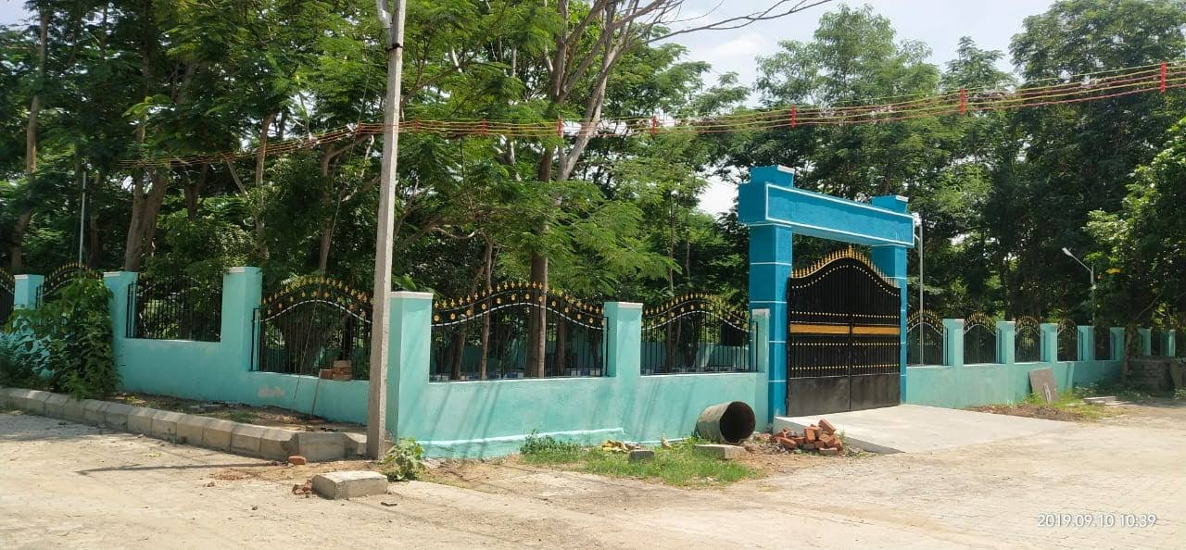
Green Space Development - Phase II (58 Parks)
1. | DESCRIPTION OF WORK | : | Providing New Green Park development at Senguttai Teacher`s Colony and Old Katpadi Bharaneeswaram in Ward No:3 & 4, Andal Nagar in Ward No:8, Hariyanth Nagar Near Jain School in Ward No:11, Selvam Nagar in Ward No:8, Venkataswara Nagar in Ward No:10, Bank Nagar in Ward No:10, etc., in 4 Zones.
2. | PROJECT COST | : | Rs. 10.34 Crores
3. | DATE OF TENDER | : | 13.11.2018
4. | NAME OF THE CONTRACTOR | : | Mr/s. R.Vasanthy,Vellore - Pkg 1- 25 Parks M/s. Krishna and Co, Vellore - Pkg 2 - 21 Parks Thiru. R.S Prabhakaran, Vellore - Pkg 3 - 3 Parks V.K. Mahesh, Vellore - Pkg 4 - 9 Parks (2 dropped)
5. | AGREEMENT DATE | : | 04.01.2019
6. | AGREEMENT AMOUNT | : | Rs. 8.95 Crores
7. | AGREEMENT PERIOD | : | 8 months (04.09.2019)
8. | PRESENT STAGE OF WORK | : | i) 53 Parks Completed ii) 3 Parks work in Progress iii) 2 Parks alternate to be done. |  | Pkg 1 - 24 Completed 1 in progress Pkg 2 - 21 Completed Pkg 3 - 3 Completed Pkg 4 - 7 Completed, 2 Dropped
9. | DATE OF COMPLETION | : | 30.06.2020
10. | PERCENTAGE PROGRESS | : | Jun-20 |  | Jul-20
 |  |  | 98% |  | 99%
11. | EXPENDITURE | : | Rs. 5.90 Crores

Slide 6
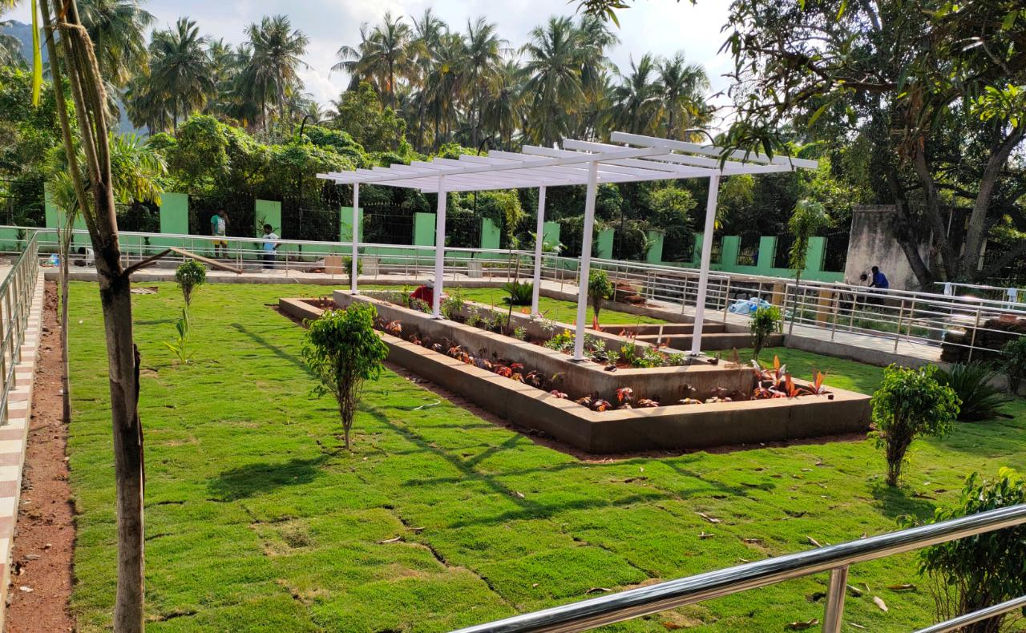
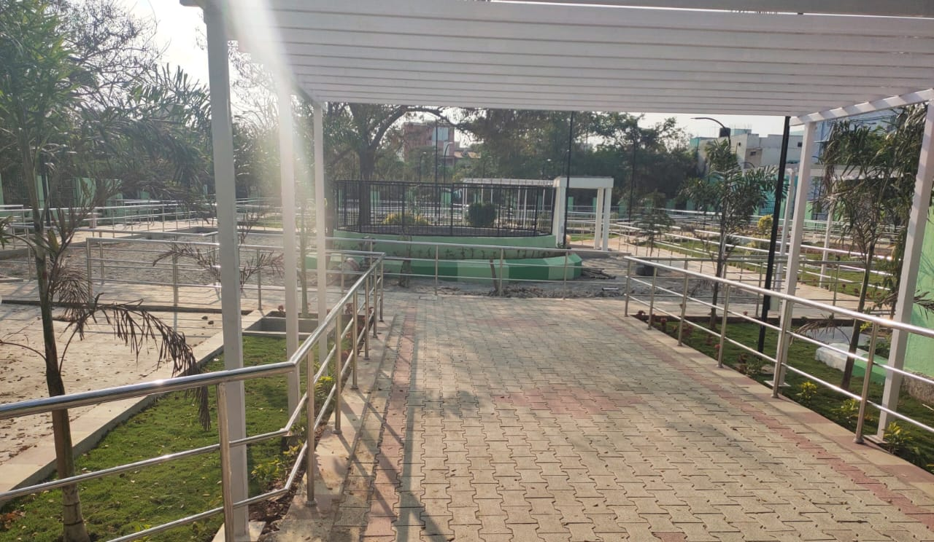
Green Space Development - Phase I - 15; Phase 2 - 23 Parks
1. | DESCRIPTION OF WORK | : | Providing New Green Park development at CMC Nursing College in Ward No:26, Science Park in Ward No:22,, Jegajothi Nagar in ward No:22,and Vigneshwara Nagar in ward No:19 at Zone -II, Vellore Corporation. (Total 4 Nos. of Parks) Providing New Green Park development at EB Nagar Park in Ward No:19, Ganapathi Nagar in Ward No;18, Sakthi Nagar in Ward No;19,Thendral Nagar in Ward No:16, Balaji Nagar in Ward No:26, CMC colony in Ward No:17, LIC Colony in Ward No:16 at Zone-II, Vellore Corporation. (Total 7 Nos. of Park) Providing New Green Park development at 10th Street CMC Colony in Ward No:17,TNHB Nagar in Ward No:19,Poonga Nagar in Ward No:19 and Vasanth Nagar in Ward No:20 at Zone-II, Vellore Corporation. (Total 4 Nos. of Parks) Providing New Park development in Zone-I, Vellore Corporation-Package-1(8 Nos) Providing New Park development in Zone-II, Vellore Corporation-Package-2(10 Nos) Providing New Park development in Zone-IV, Vellore Corporation-Package-3(5 Nos)
2. | PROJECT COST | : | Rs. 20.00 Crores
3. | DATE OF TENDER | : | 19.03.2019
4. | NAME OF THE CONTRACTOR | : | V.K. Mahesh - Pkg 1 - 4 Parks M/s V M Construction - Pkg 2- 7 Parks, Pkg 3 - 4 Parks M/s Sathyanarayana Construction - Pkg 4 - 8 Parks S. SivaKumar - Pkg 5 - 10 Parks Thiru. A V Vinayagamoorthy - Pkg 6 - 5 Parks
5. | AGREEMENT DATE | : | 13.08.2019
6. | AGREEMENT AMOUNT | : | Rs. 15.99 Crores
7. | AGREEMENT PERIOD | : | 6 months (13.04.2020)
8. | PRESENT STAGE OF WORK | : | Package 1 - 4 Parks in Progress (Compound wall work in progress) Package 2 - 4 Parks in Progress (75% Completed) 2 Parks to be alternate to be fixed Package 3 - 4 parks - 95% of work completed and Finishing works in progress. | Pkg - 4 - 7completed 1 nearing Completion Pkg 5 - 4 Completed 6 to be Started Pkg 6 - 4 Completed 1 in progress | Pkg - 4 - 7completed 1 nearing Completion Pkg 5 - 4 Completed 6 to be Started Pkg 6 - 4 Completed 1 in progress
9. | DATE OF COMPLETION | : | 30.09.2020
10. | PERCENTAGE PROGRESS | : | Jun-20 | Jul-20 | Jul-20
 |  |  | 75% | 80% | 80%
11. | EXPENDITURE | : | Rs. 6.10 Crores

Slide 7
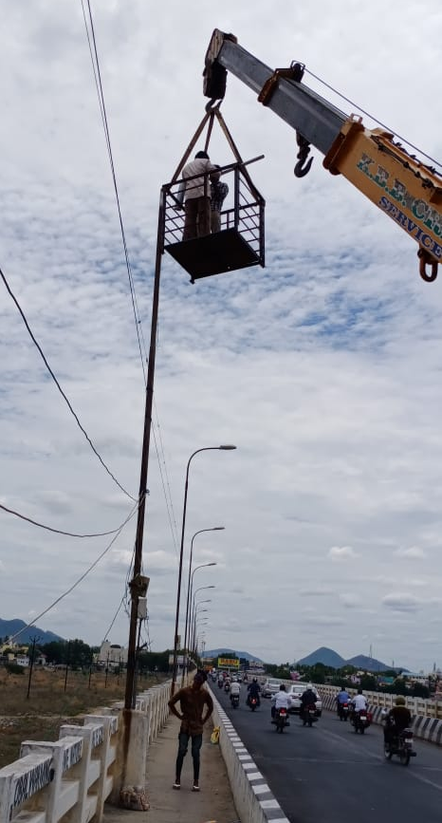
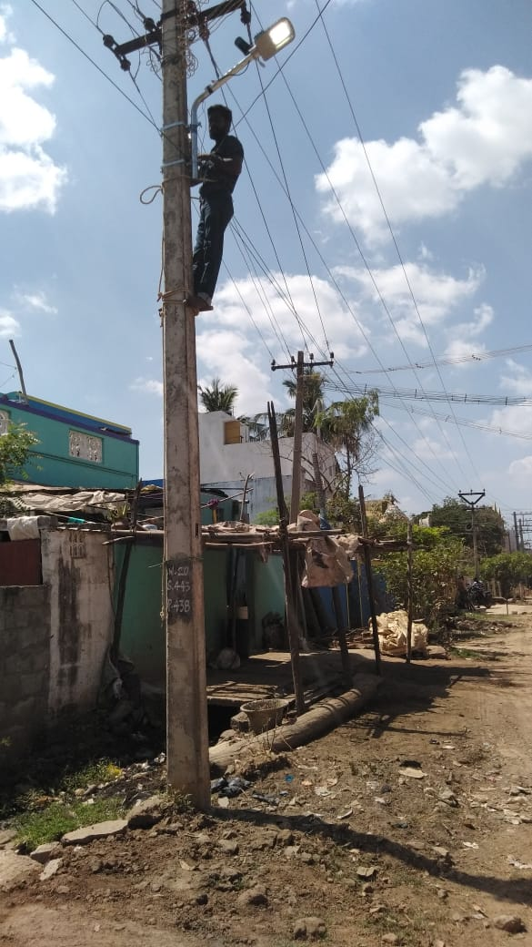
Street Light
1. | DESCRIPTION OF WORK | : | Conversion of Existing Streetlights of all categories in to LED Fixtures and Supply, erection of New Proposal of LED Streetlight Fixture With monitoring system at Zone-1, Zone-2, Zone-3 & Zone-4 in Vellore Corporation under Smart City Mission
2. | PROJECT COST | : | Rs. 30.00 Crores
3. | DATE OF TENDER | : | 07.01.2019
4. | NAME OF THE CONTRACTOR | : | M/s Schnell Energy Equipment Pvt Ltd, Coimbatore
5. | AGREEMENT DATE | : | 04.02.2019
6. | AGREEMENT AMOUNT | : | Rs. 23.88 Crores
7. | AGREEMENT PERIOD | : | 8 months (04.10.2019)
8. | PRESENT STAGE OF WORK | : | Package | Agreement | Agreement | Supply | Supply | Installation | Installation
 |  |  | 1 | 4468 | 4468 | 3950 | 3950 | 1846 | 1846
 |  |  | 2 | 3404 | 3404 | 3134 | 3134 | 1501 | 1501
 |  |  | 3 | 2753 | 2753 | 2423 | 2423 | 1295 | 1295
 |  |  | 4 | 4523 | 4523 | 4146 | 4146 | 1766 | 1766
 |  |  |  | 15148 | 15148 | 13653 | 13653 | 6408 | 6408
9. | DATE OF COMPLETION | : | 30.09.2020
10. | PERCENTAGE PROGRESS | : | Jun-20 |  |  | Jul-20 | Jul-20
 |  |  | 54% |  |  | 56% | 56%
11. | EXPENDITURE | : | Rs. 13.75 Crores

Slide 8
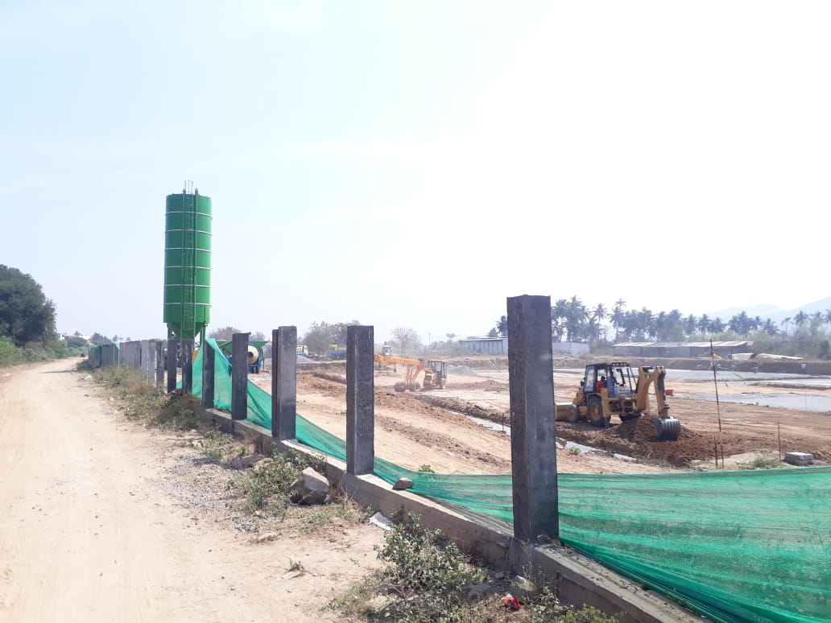
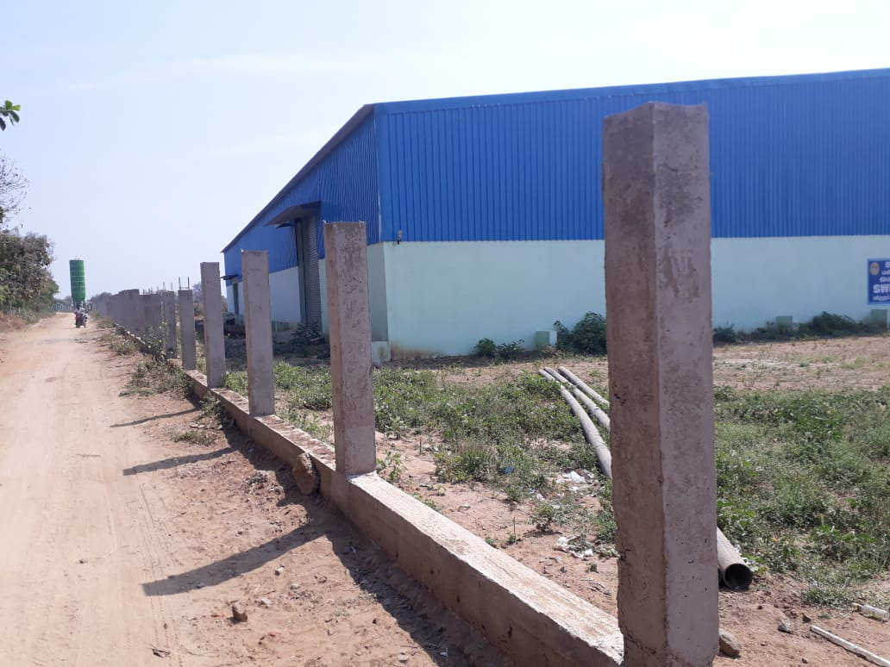
Protection Wall to STP
1. | DESCRIPTION OF WORK | : | Construction of Protection Wall at STP site and Solar Plant at Sarkar Thoppu in Vellore City Municipal Corporation
2. | PROJECT COST | : | Rs. 2.50 crores
3. | DATE OF TENDER | : | 28.01.2019
4. | NAME OF THE CONTRACTOR | : | Mr/s. D. Natrajan & Co
5. | AGREEMENT DATE | : | 02.08.2019
6. | AGREEMENT AMOUNT | : | Rs. 2.14 Crores
7. | AGREEMENT PERIOD | : | 12 months (02.08.2020)
8. | PRESENT STAGE OF WORK | : | Compound Wall - Column & Grade beam 800m completed out of 2400m and remaining in Progress.
9. | DATE OF COMPLETION | : | 30.09.2020
10. | PERCENTAGE PROGRESS | : | Jun-20 | Jul-20
 |  |  | 30% | 35%
11. | EXPENDITURE | : | -

Slide 9
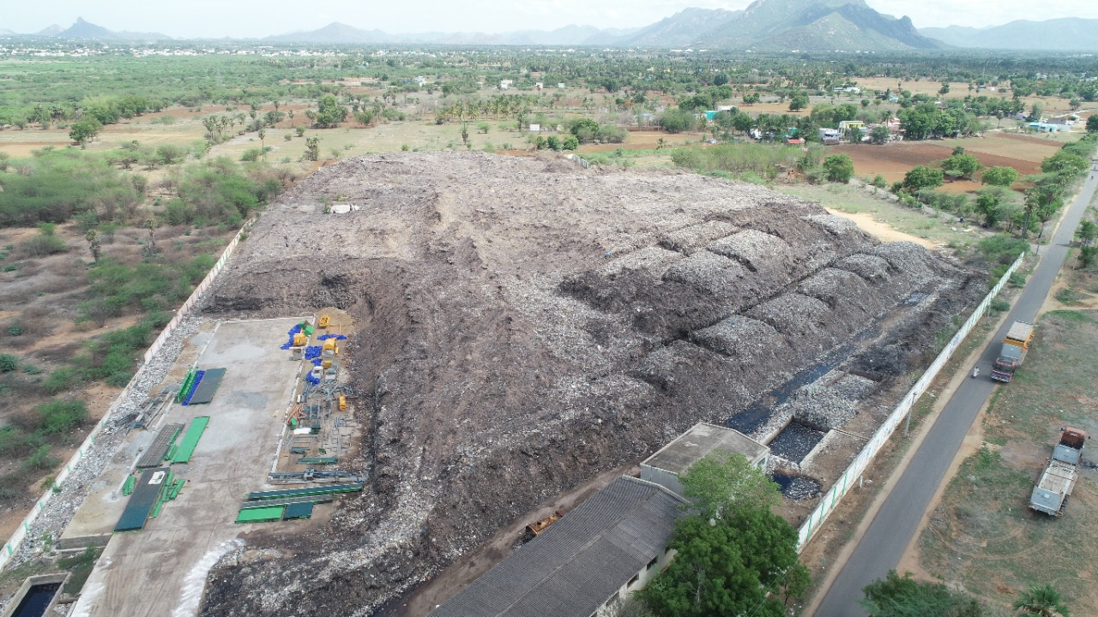
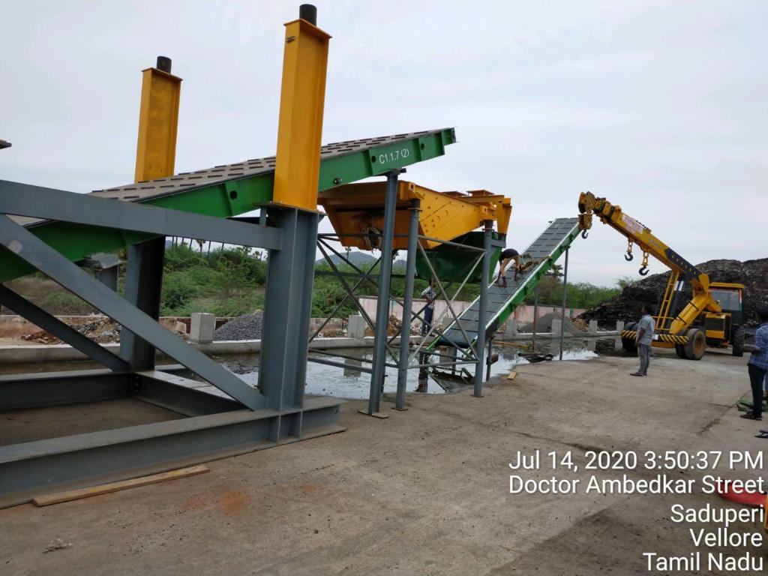
Bio Mining
1. | DESCRIPTION OF WORK | : | Removal of Legacy Waste At Existing Municipal Soild Waste Dumpsite at Sathuperi through Biomining in Vellore City Municipal Corporation
2. | PROJECT COST | : | Rs. 13.00 Crores
3. | DATE OF TENDER | : | 18.02.2019
4. | NAME OF THE CONTRACTOR | : | M/s.EcoGarb(Consortium),Chennai.
5. | AGREEMENT DATE | : | 27.05.2019
6. | AGREEMENT AMOUNT | : | Rs. 12.78 Crores
7. | AGREEMENT PERIOD | : | 24 months (27.05.2021)
8. | PRESENT STAGE OF WORK | : | 1. 20000Cum of legacy waste was shifted and site cleared for shed work. 2. Heaping and Bio culture carried out for 12000cum. 3.Machineries arrived to site and erection in progress. 4.Shed Erection work yet to be commenced.
9. | DATE OF COMPLETION | : | 30.05.2021
10. | PERCENTAGE PROGRESS | : | Jun-20 | Jul-20 | Jul-20
 |  |  | 12% | 15% | 15%
11. | EXPENDITURE | : | -

Slide 10
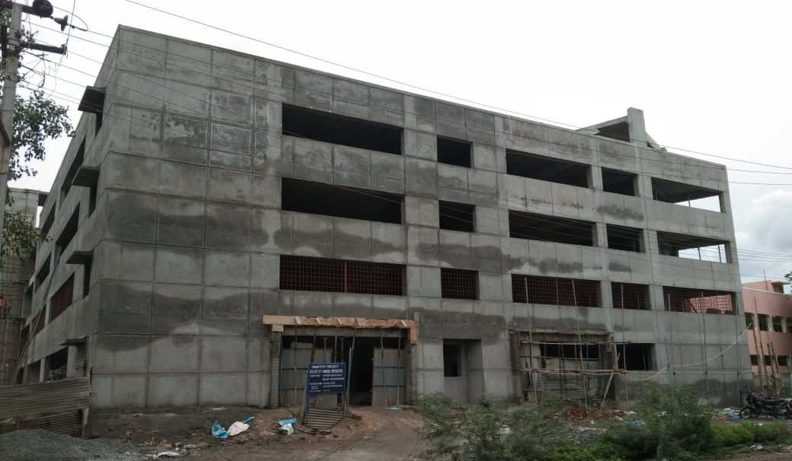
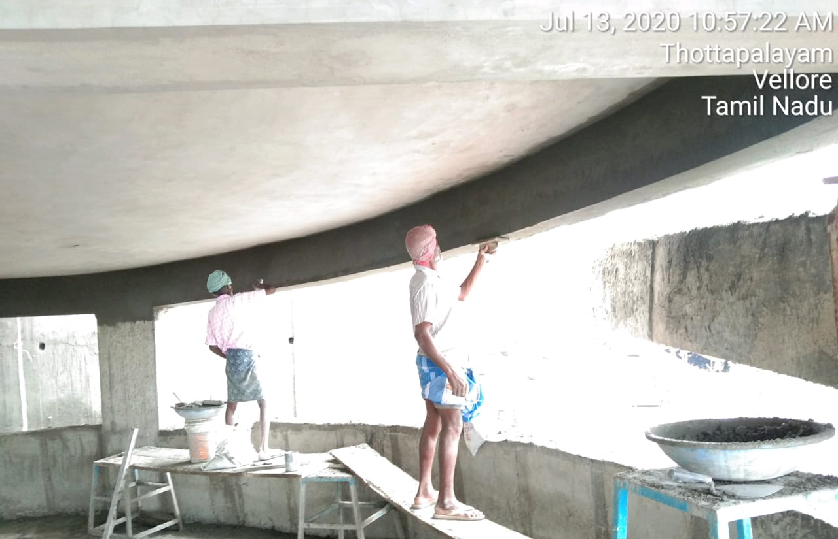
Multi Level Car Parking
1. | DESCRIPTION OF WORK | : | Establishing of Multi Level Car Parking at New Bus stand in Zone 4 in Vellore City Municipal Corporation(ABD Area)
2. | PROJECT COST | : | Rs. 11.03 Cr
3. | DATE OF TENDER | : | 05.03.2019
4. | NAME OF THE CONTRACTOR | : | M/s. VM Construction, Gudiyattam.
5. | AGREEMENT DATE | : | 09.03.2019
6. | AGREEMENT AMOUNT | : | Rs. 9.67 Crores
7. | AGREEMENT PERIOD | : | 24 months (09.03.2021)
8. | PRESENT STAGE OF WORK | : | i) Structure completed up to Terrace. ii) Building outer plastering in progress.
9. | DATE OF COMPLETION | : | 30.06.2021
10. | PERCENTAGE PROGRESS | : | Jun-20 | Jul-20
 |  |  | 55% | 65%
11. | EXPENDITURE | : | Rs. 6.40 Cr

Slide 11
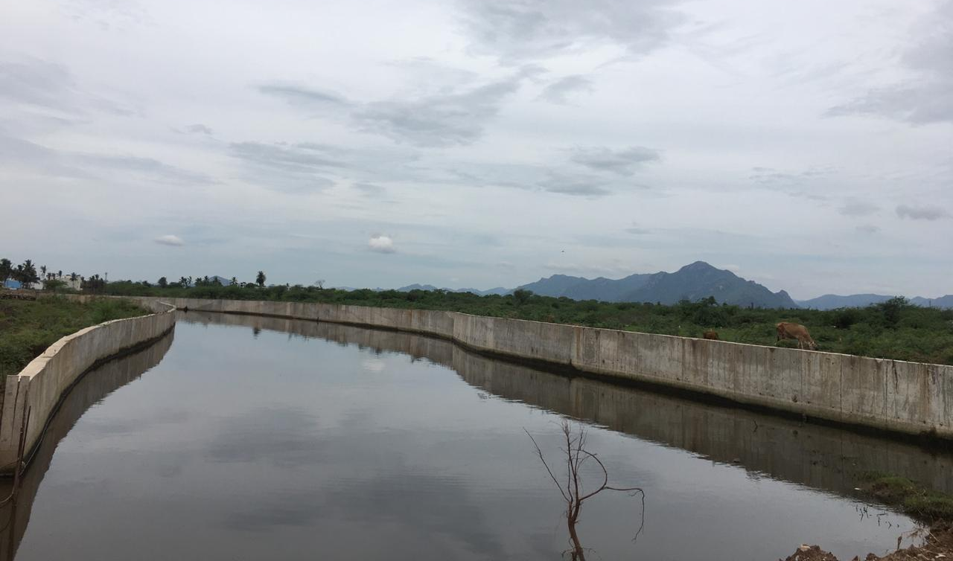
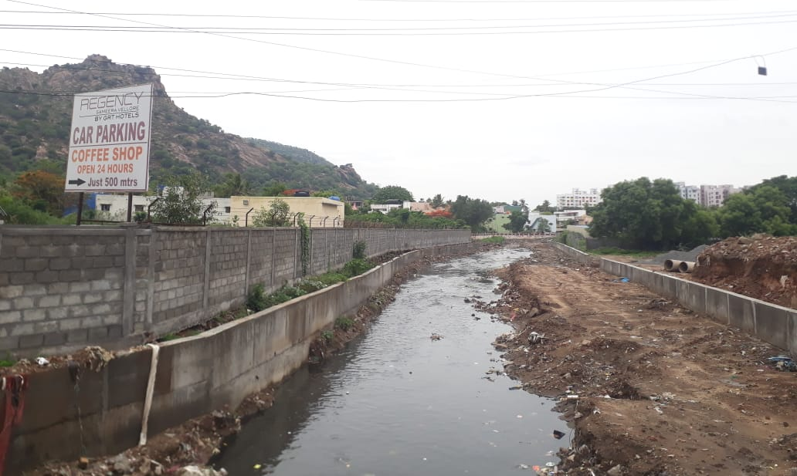
Storm Water Drain - RCC lining - 6.20 Km
1. | DESCRIPTION OF WORK | : | Construction of Side Retaining Wall for a length of 3.80km and Landscaping at Channel from Old Bye Pass Road to Hotel Riverview Junction, Palar River to Mangaimundy and Mangaimundy to Kasalpet Anjinayar Koil street Zone-IV Construction of Side Retaining Wall for 2.40 km and Landscaping at Nickalsan Channel from Hotel River View to Thenral Nagar Back side Zone-II
2. | PROJECT COST | : | Rs. 29.00 Cr
3. | DATE OF TENDER | : | 26.02.2019
4. | NAME OF THE CONTRACTOR | : | M/s. Kumar Builders, Ranipet; M/s J K Construction, Vellore
5. | AGREEMENT DATE | : | 09.03.2019
6. | AGREEMENT AMOUNT | : | Rs. 25.14 Cr
7. | AGREEMENT PERIOD | : | 12 months (09.03.2020)
8. | PRESENT STAGE OF WORK | : | Retaining Wall 2950m completed out of 6200m Remaining Length in progress. Pkg 1 - 1600m/3800m Pkg 2 - 1300/2400m
9. | DATE OF COMPLETION | : | 31.03.2021
10. | PERCENTAGE PROGRESS | : | Jun-20 | Jul-20
 |  |  | 42% | 46%
11. | EXPENDITURE | : | Rs. 11.28 Crores

Slide 12
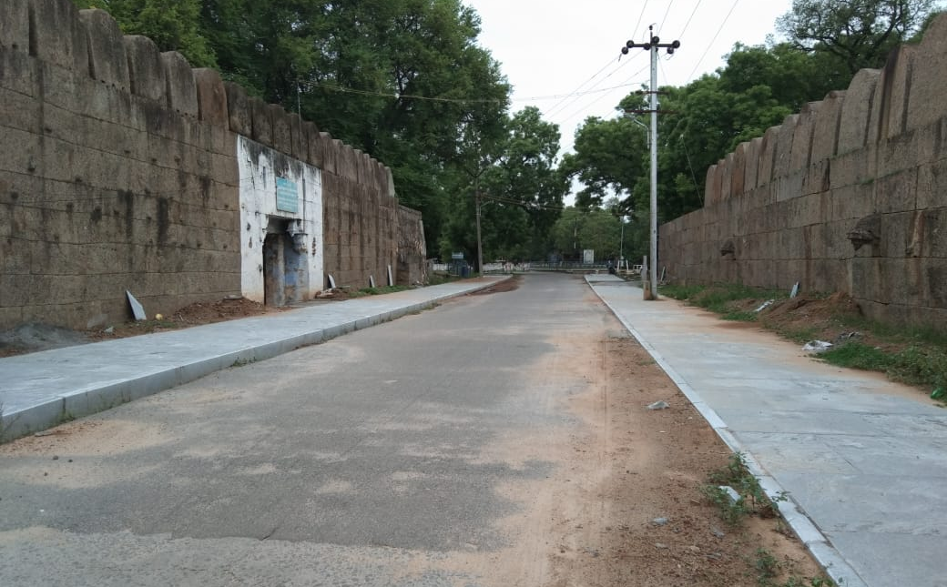
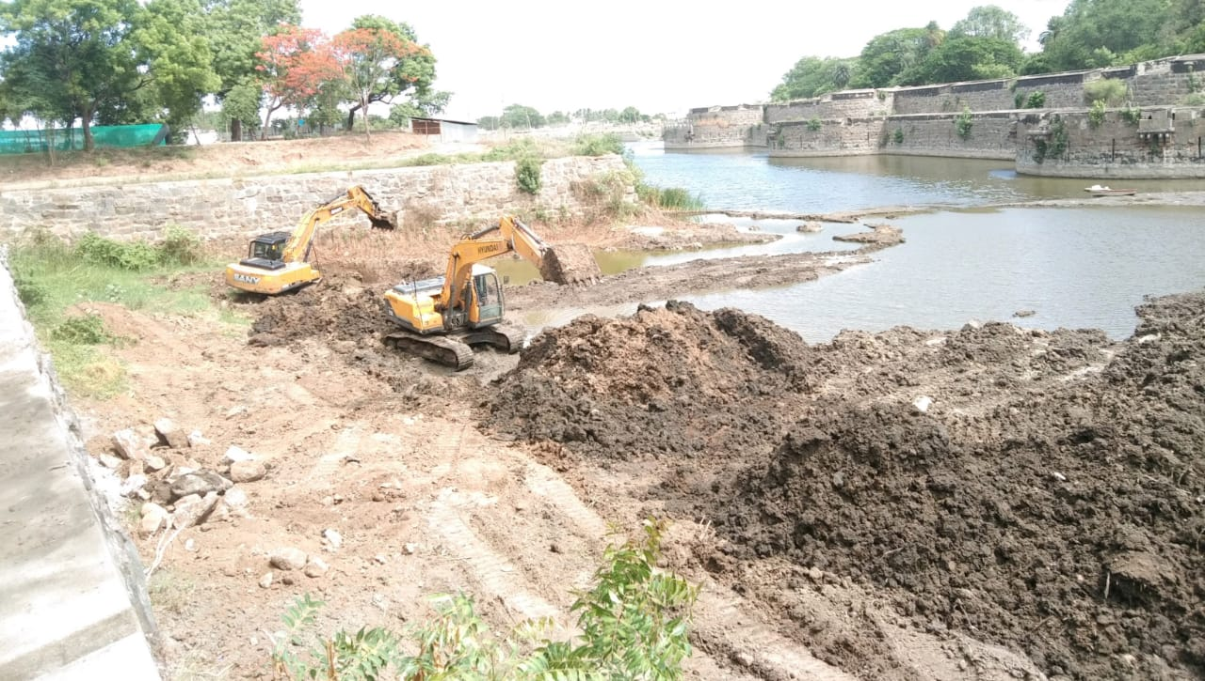
Tourism Development - SOR Items - Part 1
1. | DESCRIPTION OF WORK | : | Integrated Tourism Development of Vellore Fort and Precincts Part-1
2. | PROJECT COST | : | Rs. 10.80 Cr
3. | DATE OF TENDER | : | 26.02.2019
4. | NAME OF THE CONTRACTOR | : | M/s. Kumar Builders, Ranipet
5. | AGREEMENT DATE | : | 09.03.2019
6. | AGREEMENT AMOUNT | : | Rs. 9.37 Cr
7. | AGREEMENT PERIOD | : | 18 months (26.06.2020)
8. | PRESENT STAGE OF WORK | : | i) Moat Desilting 85% Completed ii) Footpath Completed 200m/1400m
9. | DATE OF COMPLETION | : | 30.09.2020
10. | PERCENTAGE PROGRESS | : | Jun-20 | Jul-20
 |  |  | 55% | 58%
11. | EXPENDITURE | : | -

Slide 13
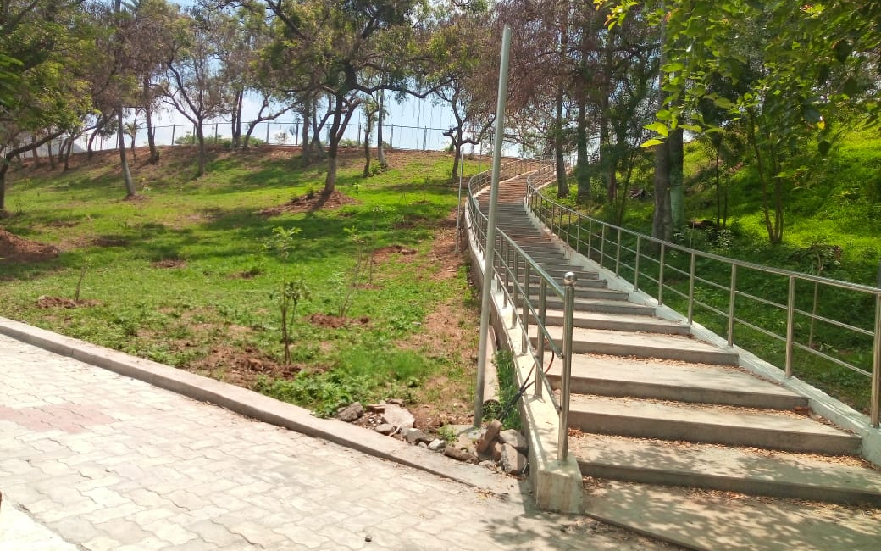
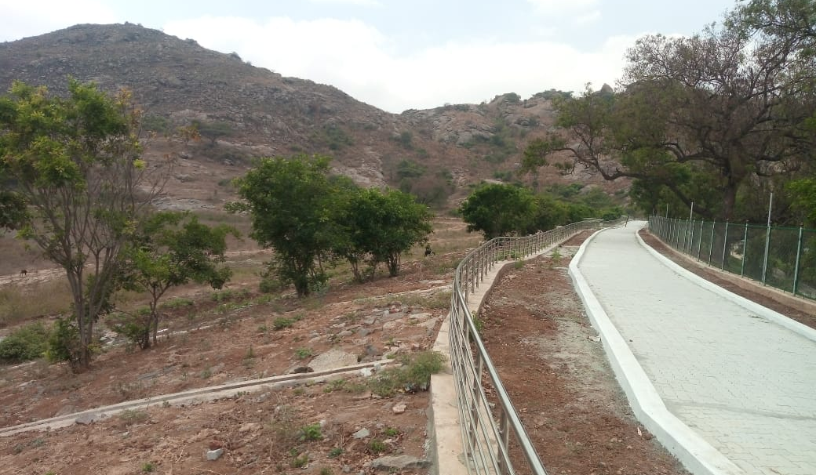
Otteri Lake Development
1. | DESCRIPTION OF WORK | : | Providing Walkways, Development of Green space and Beautification of Otteri Lake including desilting works
2. | PROJECT COST | : | Rs. 9.00 Cr
3. | DATE OF TENDER | : | 28.02.2019
4. | NAME OF THE CONTRACTOR | : | M/s. Kumar Builders, Ranipet
5. | AGREEMENT DATE | : | 09.03.2019
6. | AGREEMENT AMOUNT | : | Rs. 6.34 Cr
7. | AGREEMENT PERIOD | : | 12 months (09.03.2020)
8. | PRESENT STAGE OF WORK | : | 87% of the Work completed. Gardening maintenance work. Entrance Arch work, High mast lights erection to be completed.
9. | DATE OF COMPLETION | : | 30.08.2020
10. | PERCENTAGE PROGRESS | : | Jun-20 | Jul-20
 |  |  | 87% | 90%
11. | EXPENDITURE | : | Rs. 5.58 Cr

Slide 14
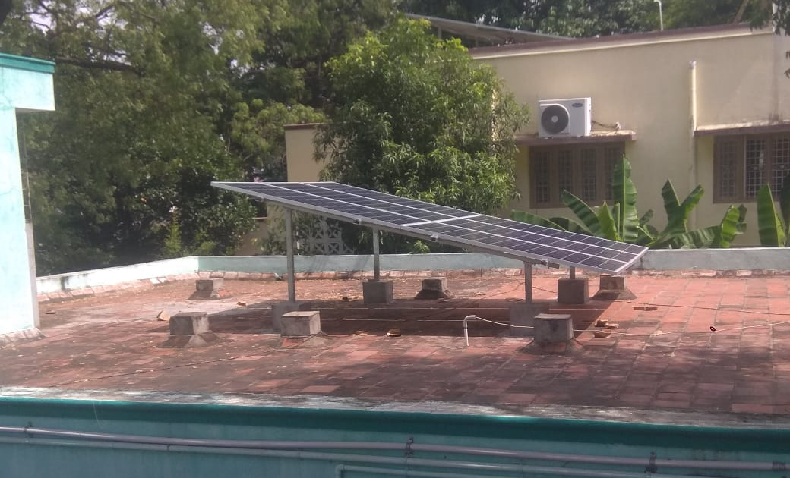
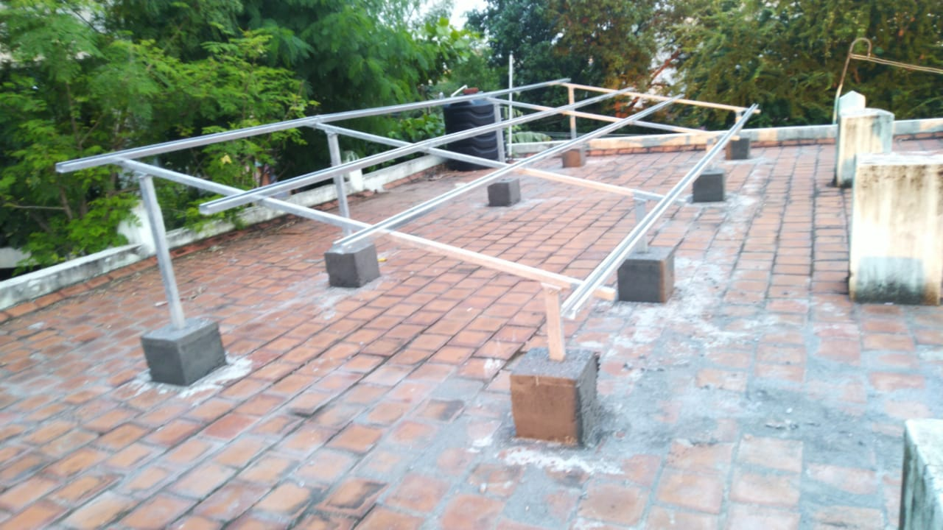
Solar Roof Top (129 Buildings)
1. | DESCRIPTION OF WORK | : | Supply, Installation, Testing, Commissioning and five years Comprehensive operation and maintenance of Roof Top Solar PV System(on Grid)in Vellore City Municipal Corporation Buildings
2. | PROJECT COST | : | Rs. 3.81 Cr
3. | DATE OF TENDER | : | 04.03.2019
4. | NAME OF THE CONTRACTOR | : | M/s. Green Field solar Solutions Pvt Ltd, Chennai
5. | AGREEMENT DATE | : | 09.03.2019
6. | AGREEMENT AMOUNT | : | Rs. 2.69 Cr
7. | AGREEMENT PERIOD | : | 12 months (09.03.2020)
8. | PRESENT STAGE OF WORK | : | i) Erection of Solar panels completed for 62 buildings ii) Installation of Batteries, Invertors and Electrical Works in progress iii) Remaining building Erection of Panels in progress. iv) Frames erected for 120 buildings.
9. | DATE OF COMPLETION | : | 30.09.2020
10. | PERCENTAGE PROGRESS | : | Jun-20 | Jul-20
 |  |  | 82% | 85%
12. | EXPENDITURE | : | Rs.1.37 Cr

Slide 15
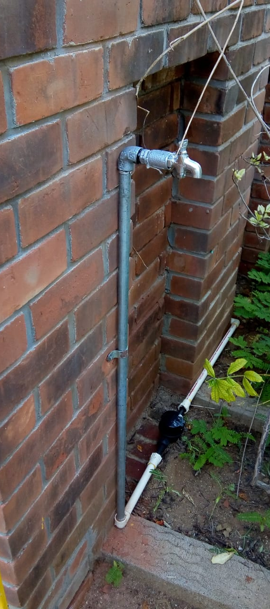
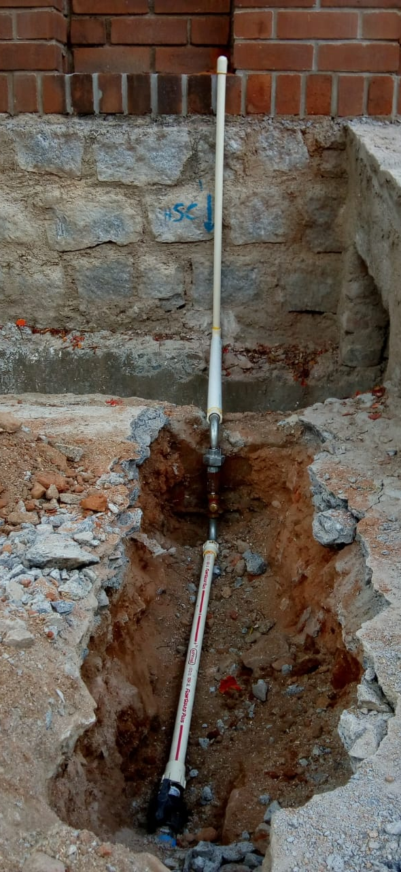
Water Supply Internal Plumbing
1. | DESCRIPTION OF WORK | : | Providing 47698 water Supply Internal Plumbing works for left out House Service Connection in Vellore City Municipal Corporation
2. | PROJECT COST | : | Rs. 11.30 Cr
3. | DATE OF TENDER | : | 12.02.2019
4. | NAME OF THE CONTRACTOR | : | Thiru.T. Saravanan, Vellore
5. | AGREEMENT DATE | : | 09.03.2019
6. | AGREEMENT AMOUNT | : | Rs. 9.97 Cr
7. | AGREEMENT PERIOD | : | 12 months (09.03.2020)
8. | PRESENT STAGE OF WORK | : | 14582 nos internal pipe Connection completed out of 47698 nos. | Zone 1 - 7077 Zone 2 - 1780 Zone 3 - 1469 Zone 4 - 4272
9. | DATE OF COMPLETION | : | 30.09.2020
10. | PERCENTAGE PROGRESS | : | Jun-20 | Jul-20
 |  |  | 25% | 30%
11. | EXPENDITURE | : | Rs. 2.87 Cr

Slide 16
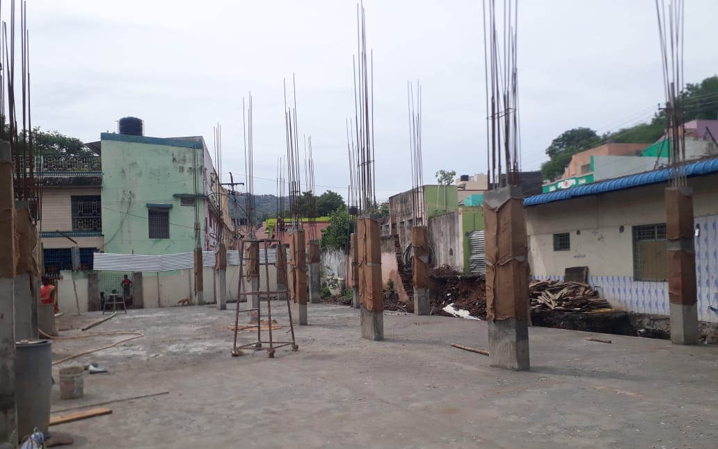
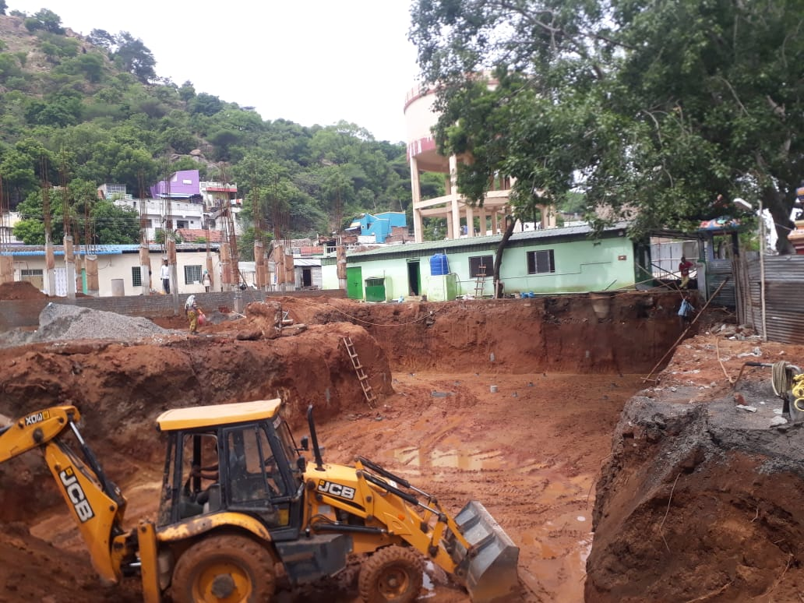
Construction of Commercial complex at Sathuvachari
1. | DESCRIPTION OF WORK | : | Construction of Commercial Complex at Sathuvachari Amma Unavagam Campus in Vellore Corporation
2. | PROJECT COST | : | Rs. 5.20 Cr
3. | DATE OF TENDER | : | 08.04.2019
4. | NAME OF THE CONTRACTOR | : | M/s.V.M.Construction, Gudiyattam
5. | AGREEMENT DATE | : | 14.06.2019
6. | AGREEMENT AMOUNT | : | Rs. 4.25 Cr
7. | AGREEMENT PERIOD | : | 12 months (14.06.2020)
8. | PRESENT STAGE OF WORK | : | i) Dismantling of Existing structure completed. ii) Basement work in progresss iii) Superstructure Column Work in Progress
9. | DATE OF COMPLETION | : | 31.03.2021
10. | PERCENTAGE PROGRESS | : | Jun-20 | Jul-20
 |  |  | 2% | 10%
11. | EXPENDITURE | : | -

Slide 17
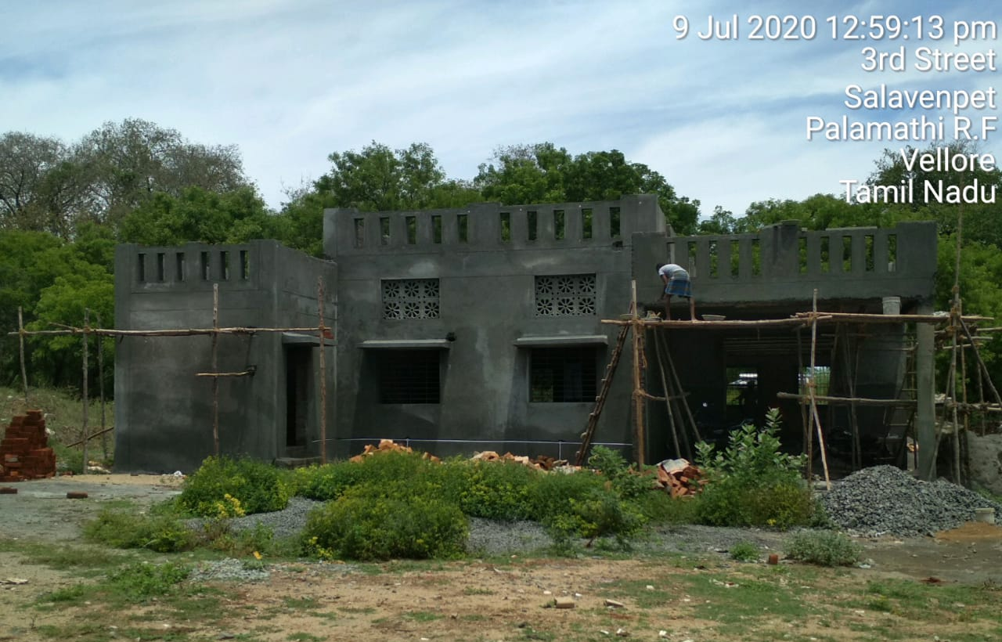
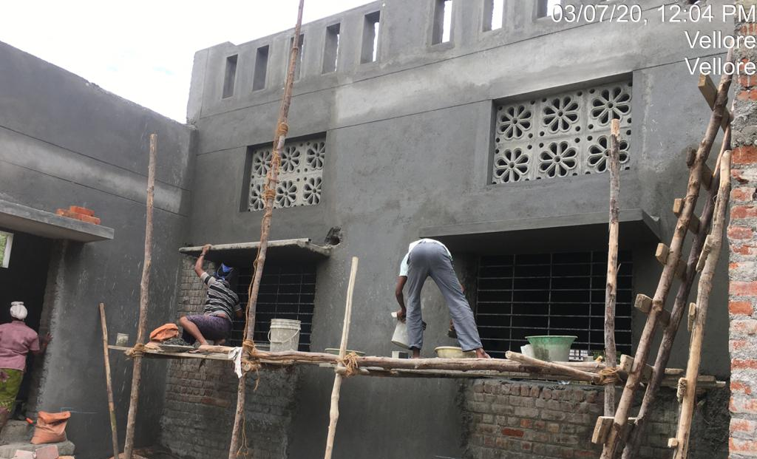
Crematorium
1. | DESCRIPTION OF WORK | : | Construction of Gasifier Crematorium at Ammanankuttai in Zone 3, Vellore
2. | PROJECT COST | : | Rs. 2.00 Cr
3. | DATE OF TENDER | : | 13.11.2018
4. | NAME OF THE CONTRACTOR | : | M/s.Goodcare Enviro System Pvt Ltd, Chennai
5. | AGREEMENT DATE | : | 26.12.2018
6. | AGREEMENT AMOUNT | : | Rs. 1.63 Cr
7. | AGREEMENT PERIOD | : | 8 months (26.08.2019)
8. | PRESENT STAGE OF WORK | : | i) Structure completed up to Roof Slab. Compound Wall work in progress (50% completed). ii) Machineries are procured & erection to be started. iii) Outer Plastering work in progress.
9. | DATE OF COMPLETION | : | 30.09.2020
10. | PERCENTAGE PROGRESS | : | Jun-20 | Jul-20
 |  |  | 75% | 80%
11. | EXPENDITURE | : | Rs. 0.70 Cr

Slide 18
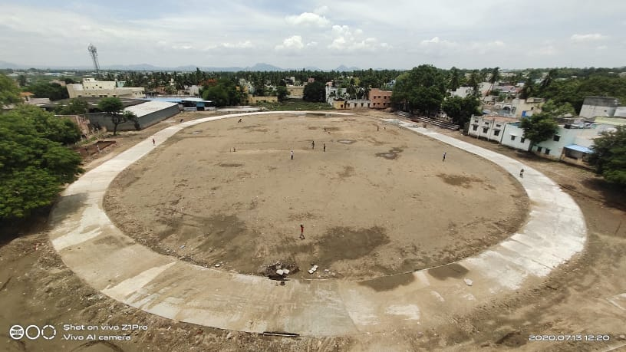
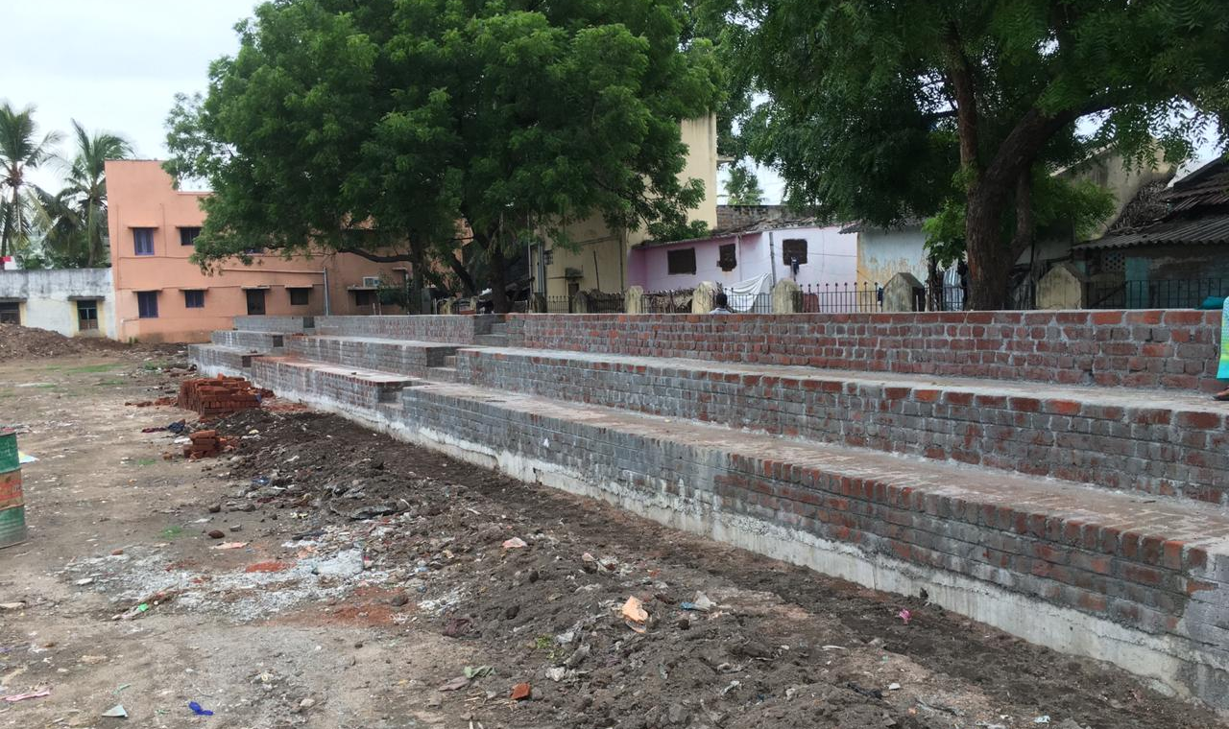
Kaspa Play Ground
1. | DESCRIPTION OF WORK | : | Development of Multi Sports Complex at Corporation (KASPA) - Phase 1
2. | PROJECT COST | : | Rs. 5.00 Cr
3. | DATE OF TENDER | : | 07.12.2018
4. | NAME OF THE CONTRACTOR | : | M/s. Kumar Builders, Ranipet
5. | AGREEMENT DATE | : | 11.01.2019
6. | AGREEMENT AMOUNT | : | Rs. 3.39 Cr
7. | AGREEMENT PERIOD | : | 18 months (11.09.2020)
8. | PRESENT STAGE OF WORK | : | Volley Ball Court, Basket Ball Court, Skating Court, Toilet Block Works completed. Jogging Track, Entrance Arch & Open Gallery work in progress.
9. | DATE OF COMPLETION | : | 31.03.2021
10. | PERCENTAGE PROGRESS | : | Jun-20 | Jul-20 | Jul-20
 |  |  | 48% | 51% | 51%
11. | EXPENDITURE | : | Rs. 0.95Cr

Slide 19
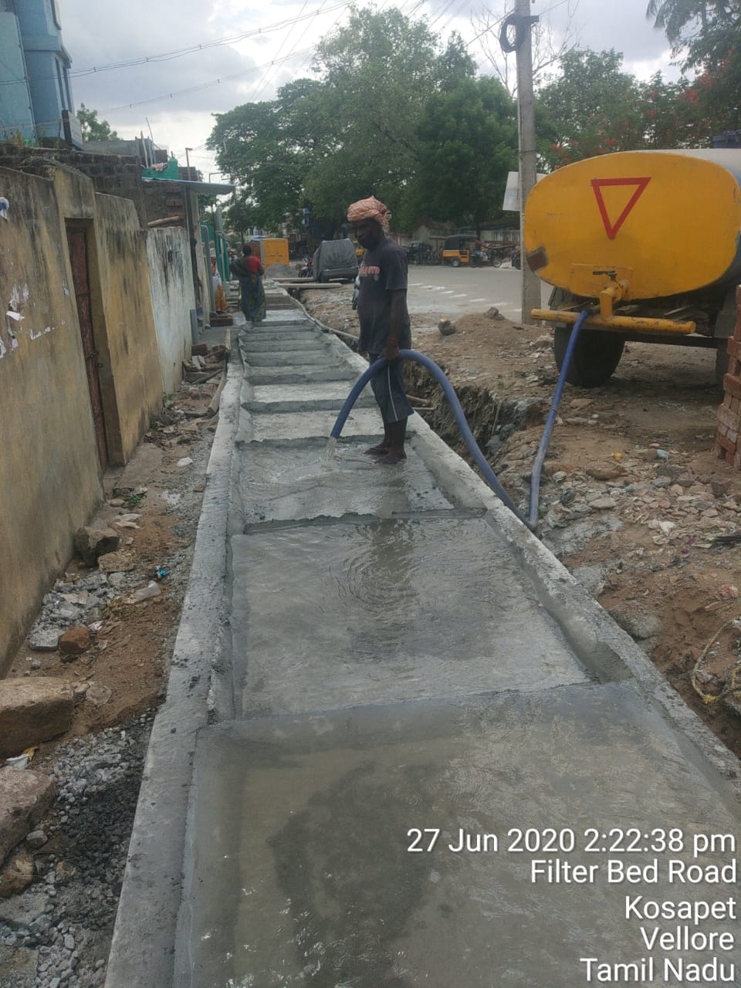
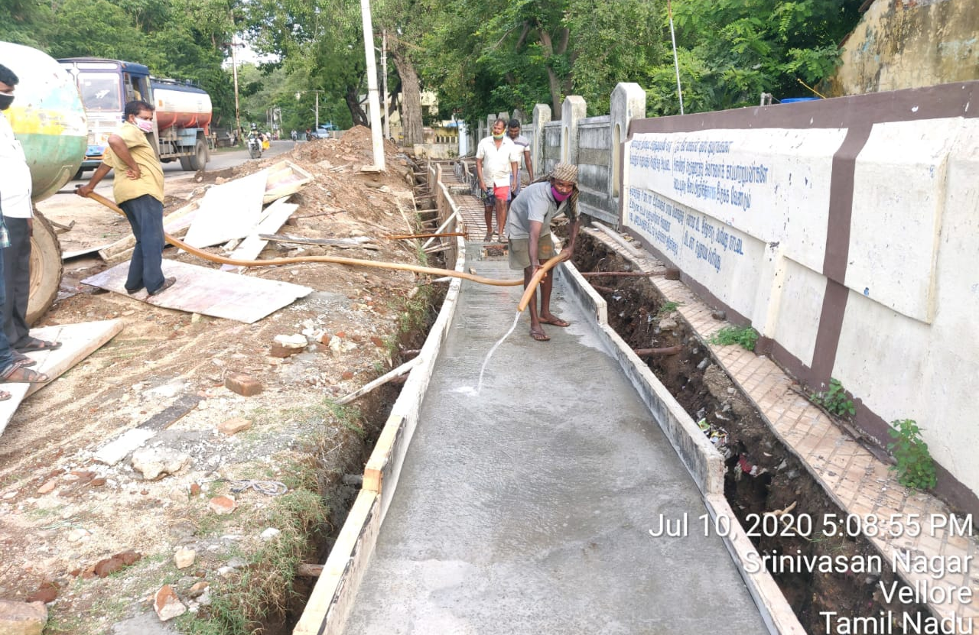
Smart Road Phase - I
1. | DESCRIPTION OF WORK | : | Providing Smart Roads at Fort Round road(Corporation Maintained Road)Package-1; Nethaji Stadium Road, Mandi Street & Kribanandha Variyar Street Package -2; Main Bazzar road, Filterbed Road Package-3; Ward Roads Package-4 in Vellore City Municipal Corporation
2. | PROJECT COST | : | Rs. 44.13 Cr
3. | DATE OF TENDER | : | 25.09.2019
4. | NAME OF THE CONTRACTOR | : | M/s. Kumar Builders, Ranipet - Pkg 1 & 4 M/s Apex Civil Engineering, Chennai - Pkg 2 & 3
5. | AGREEMENT DATE | : | 02.08.2019
6. | AGREEMENT AMOUNT | : | Rs.42.86 Cr
7. | AGREEMENT PERIOD | : | 18 months (02.02.2021)
8. | PRESENT STAGE OF WORK | : | Package 1 - SWD & EB cable duct works in progress & 20% completed in Fort Round Road. Package 2 - SWD works progress in Nethaji Road & Kirubhanandha variyar road - 80m slab completed Package 3 - SWD Work progress in Filter Bed Road & Main Bazzar Road - 420m Slab completed Package 4 - SWD Work progress in Gandhi Road - 240 slab completed
9. | DATE OF COMPLETION | : | 31.03.2021
10. | PERCENTAGE PROGRESS | : | Jun-20 | Jul-20
 |  |  | 5% | 8%
11. | EXPENDITURE | : | -

Slide 20
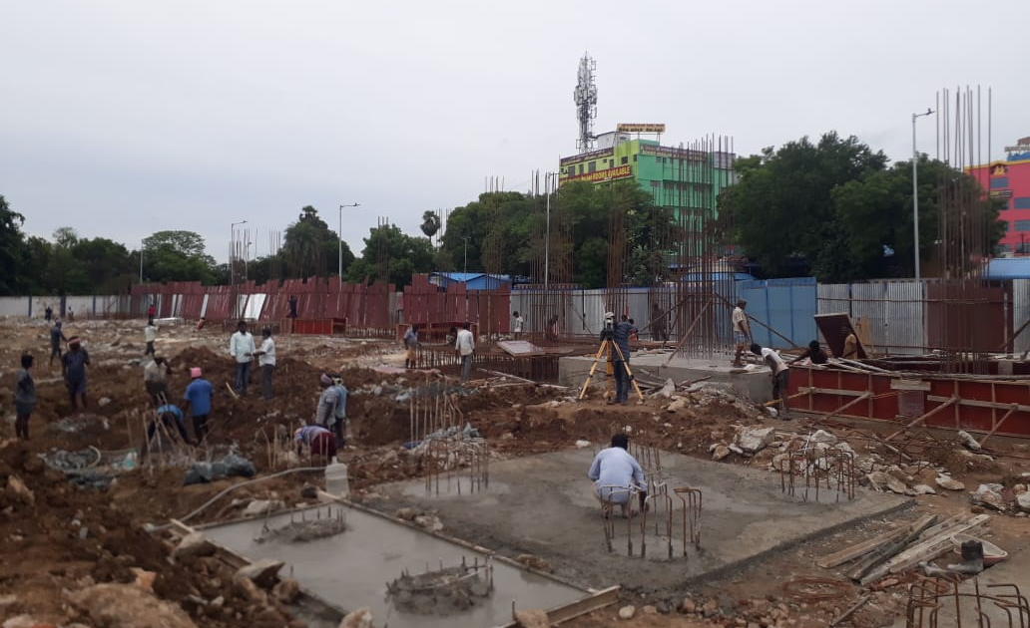
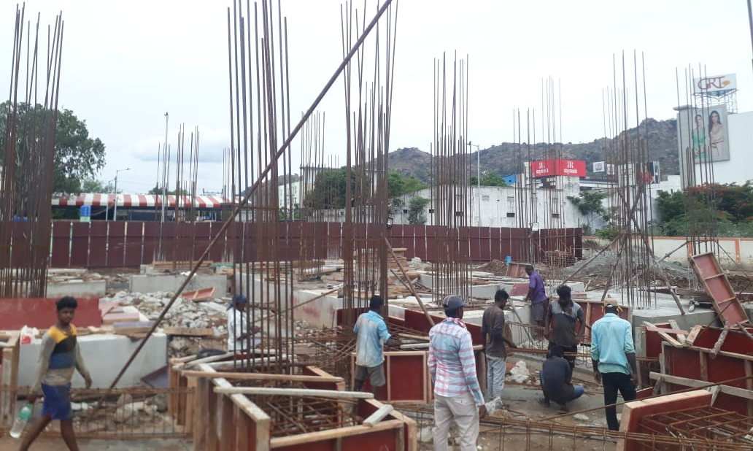
New Bus Stand
1. | DESCRIPTION OF WORK | : | New Bus Stand
2. | PROJECT COST | : | Rs. 46.51 Cr
3. | DATE OF TENDER | : | 06.11.2019
4. | NAME OF THE CONTRACTOR | : | M/s. Kumar Builders, Ranipet
5. | AGREEMENT DATE | : | 31.12.2019
6. | AGREEMENT AMOUNT | : | Rs. 46.08 Cr
7. | AGREEMENT PERIOD | : | 24 months
8. | PRESENT STAGE OF WORK | : | i) Pile Boring work in Progress 780 piles completed out of 789 piles. ii) Pile Cap work in progress iii) Surveying work in progress.
9. | DATE OF COMPLETION | : | 31.12.2021
10. | PERCENTAGE PROGRESS | : | Jun-20 | Jul-20
 |  |  | 5% | 12%
11. | EXPENDITURE | : | Rs. 4.60 Cr

Slide 21
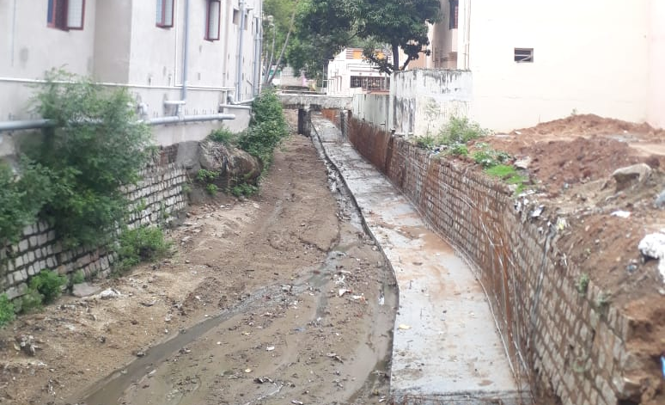
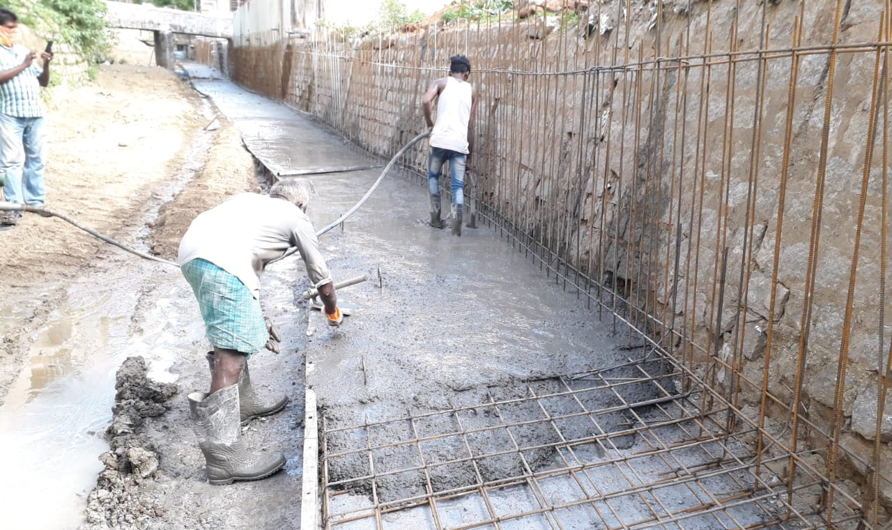
Smart Drain at Zone II
1. | DESCRIPTION OF WORK | : | Smart Drainage works and Improvement of Channels including channels widening and Side Protection wall from NHAI Road (Om Sai Nagar to Sri Ram Nagar and Vallar to Sathuvacheri Water Tank in Kagithapattarai and South Avenue Road to NHAI Road (Om Sakthi Koil) in Zone II (ABD area) in Vellore Corporation
2. | PROJECT COST | : | Rs. 10.00 Cr
3. | DATE OF TENDER | : | 18.12.2019
4. | NAME OF THE CONTRACTOR | : | M/s. JK constructions, Vellore
5. | AGREEMENT DATE | : | 26.05.2020
6. | AGREEMENT AMOUNT | : | Rs. 10.00 Cr
7. | AGREEMENT PERIOD | : | 12 months (26.05.2021)
8. | PRESENT STAGE OF WORK | : | 60m Raft completed out of 555m
9. | DATE OF COMPLETION | : | 31.03.2021
10. | PERCENTAGE PROGRESS | : | Jun-20 | Jul-20
 |  |  | 2% | 6%
11. | EXPENDITURE | : | -

Slide 22
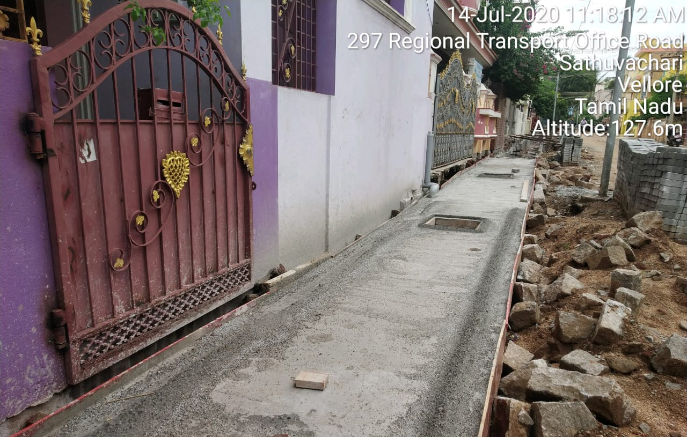
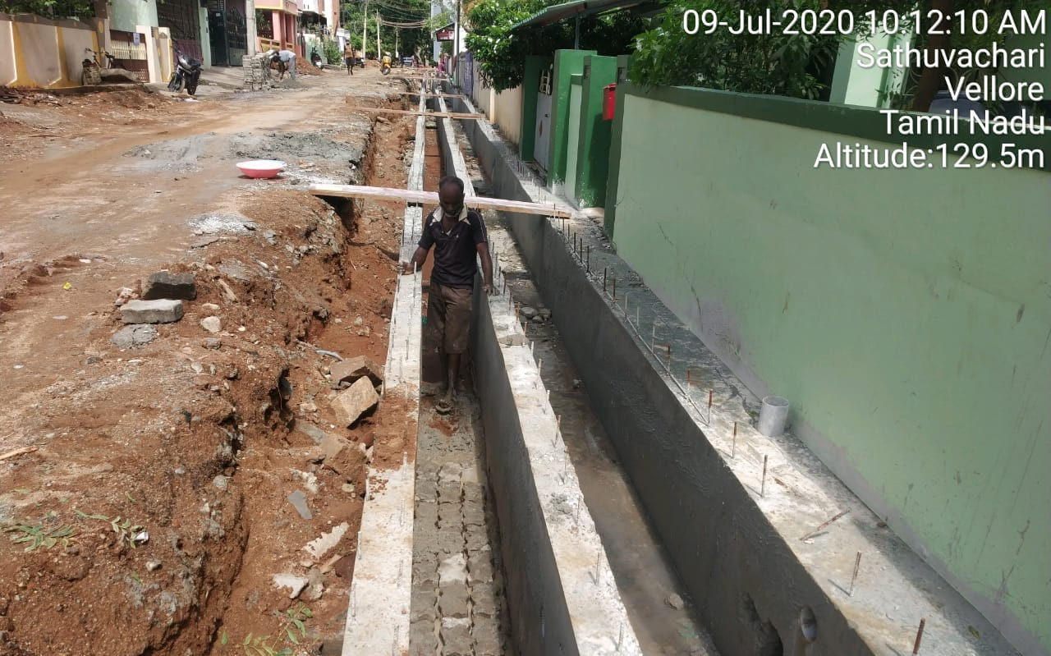
Smart Road Phase 2 & 3
1. | DESCRIPTION OF WORK | : | Providing Smart roads at Phase 1 Sathuvachary 11th street, 12th street, 13th street and 14th street -0.95km + 12 Packages of Roads
2. | PROJECT COST | : | Rs. 133.00 Cr
3. | DATE OF TENDER | : | 11.02.2020
4. | NAME OF THE CONTRACTOR | : | M/s Kumar Builders; M/s Thiru. M.V. Mathi, Arcot; Thiru. V Narayanan, Thiruvallur; M/s SP Builders, Vellore;Thiru. P. Radhakrishnan, Chennai; M/s. JK constructions, Vellore; Thiru. G. Sakthivel, Vellore; Thiru. S.Sureshkumar, Vellore; Thiru, Kutti, Vellore, Thiru D. Surendrababu, Vellore; & Thiru. A. Sakthivel, Vellore
5. | AGREEMENT DATE | : | 27.05.2020
6. | AGREEMENT AMOUNT | : | Rs. 118.79 Cr
7. | AGREEMENT PERIOD | : | 18 Month (27.11.2021)
8. | PRESENT STAGE OF WORK | : | Phase 2 - Package 1, 6 & 7 Started in progress Phase 3 - Package 1 & 4 - Storm Water Drain Slab 281m completed.
9. | DATE OF COMPLETION | : | 31.04.2021
10. | PERCENTAGE PROGRESS | : | Jun-20 | Jul-20
 |  |  | 0% | 2%
11. | EXPENDITURE | : | -

Slide 23
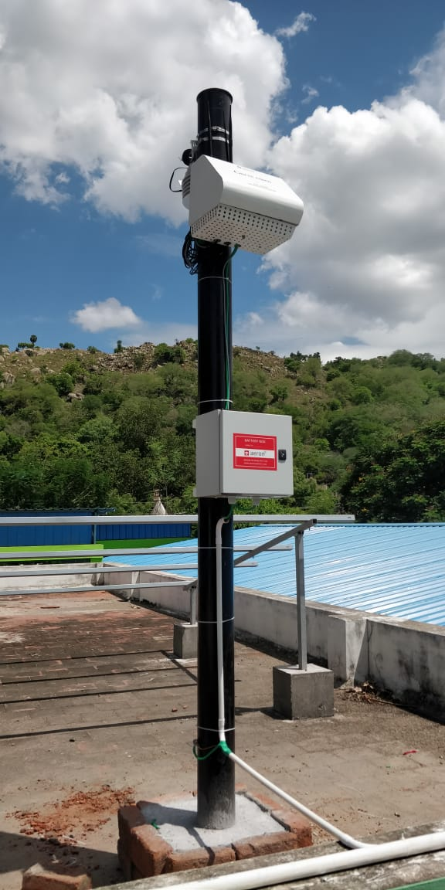
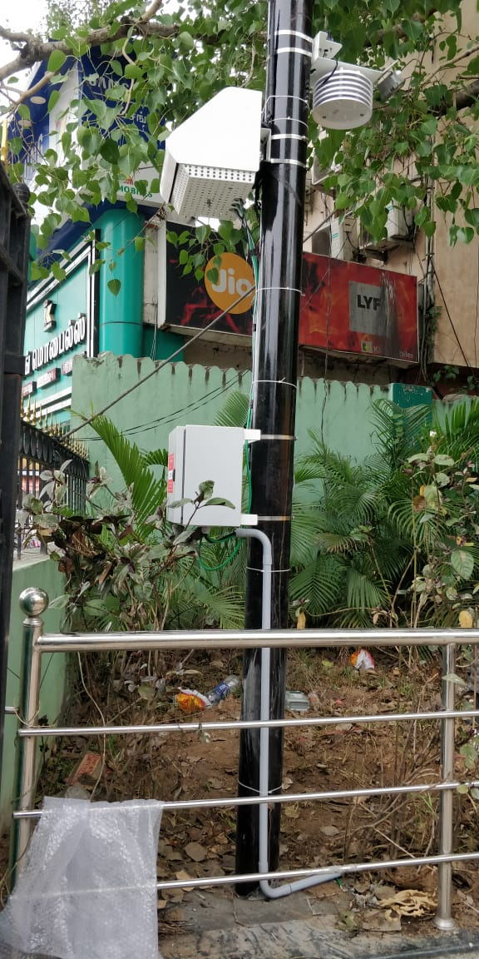
Air Quality Monitoring
1. | DESCRIPTION OF WORK | : | Providing 8 air quality monitoring Units (2 in each 4 Zones)
2. | PROJECT COST | : | Rs. 1.00 Cr
3. | DATE OF TENDER | : | 14.04.2020
4. | NAME OF THE CONTRACTOR | : | M/s Harshita Engineering Pvt Ltd
5. | AGREEMENT DATE | : | 27.05.2020
6. | AGREEMENT AMOUNT | : | Rs. 1.00 Cr
7. | AGREEMENT PERIOD | : | 3 months (27.08.2020)
8. | PRESENT STAGE OF WORK | : | i) Erection completed ii) Commissioning to be done.
9. | DATE OF COMPLETION | : | 30.06.2020
10. | PERCENTAGE PROGRESS | : | Jun-20 | Jul-20
 |  |  | 0% | 100%
11. | EXPENDITURE | : | -

